Slide 1
Empowering Users Through Effective Usability
New York Technical Services Librarians
November 19, 2019 Junior Tidal Web Services & Multimedia Librarian, Assoc. Prof. New York City College of Technology, CUNY
@JuniorTidal

Slide 2
Overview
What is usability?
Why is usability testing important?
Usability and social justice
Design frameworks
Types of usability testing
Libraries and usability

Slide 3
What is usability?
Usability.gov:
“Usability refers to the quality of a user's experience when interacting with products or systems, including websites, software, devices, or applications.”
(2019). Usability evaluation basics. Usability.gov. Retrieved from https://www.usability.gov/what-and-why/usability-evaluation.html

Slide 4
What is usability?
Jakob Nielsen:
“Usability is a quality attribute that assesses how easy user interfaces are to use.”
Nielsen, J. (2012). Usability 101: Introduction to usability. Usability.gov. Retrieved from https://www.nngroup.com/articles/usability-101-introduction-to-usability/

Slide 5
What is usability?
Steve Krug:
“Usability really just means making sure something works well: that a person of average ability or experience can use the thing for its intended purpose without getting hopelessly frustrated.”
Krug, S. (2014). Don't Make Me Think, Revisited: A Common Sense Approach to Web Usability. San Francisco:New Riders.

Slide 6
Usability is NOT User Experience

Slide 7
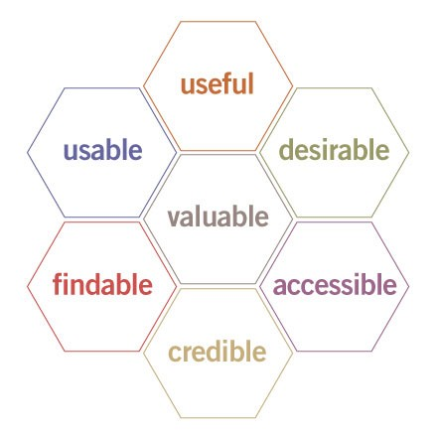
Usability is Not UX
Usability is one face of user experience.
Morville, P. (2004). User experience design. Semantic Studios. Retrieved from http://semanticstudios.com/user_experience_design/

Slide 8
Usability is Not UX
User-centered design considers the user at every step of the design process.
Morville, P. (2004). User experience design. Semantic Studios. Retrieved from http://semanticstudios.com/user_experience_design/

Slide 9
Usability is Not UX
Incorporating the user from the initial inception of a system ensures the user’s perspective.
Morville, P. (2004). User experience design. Semantic Studios. Retrieved from http://semanticstudios.com/user_experience_design/

Slide 10
Why It Usability Important?

Slide 11
Why it usability important?
Usability makes websites and systems more accessible.

Slide 12
Why it usability important?
Usability testing identifies errors and obstacles users encounter.

Slide 13
Why it usability important?
Usability can determine if using a system is a frustrating or joyful experience.

Slide 14
Why it usability important?
Example of what usability uncovers:
https://twitter.com/parsonsj/status/1181950504068210689

Slide 15
Why it usability important?
Usability saves labor and time.

Slide 16
Why it usability important?
Usability incorporates the user’s perspective into the system.

Slide 17
Usability and Social Justice

Slide 18
Usability and social justice
There is a relationship between usability and social justice.

Slide 19
Usability and social justice
National Association of Social Workers defines social justice as “the view that everyone deserves equal economic, political and social rights and opportunities” (as cited by Gonzalez, 2016).
Gonzalez, J. (2016). A collection of resources for teaching social justice. Cult of Pedagogy. Retrieved from https://www.cultofpedagogy.com/social-justice-resources/.

Slide 20
Usability and social justice
Lambert defines social justice as: “A process and also a goal to achieve a fairer society which involves actions guided by the principles of redistributive justice, recognitive justice or representational justice” (2018).
Lambert, S. R. (2018). Changing our (Dis)Course: A Distinctive Social Justice Aligned Definition of Open Education. Journal of Learning for Development, 5(3), 225-244.

Slide 21
Usability and social justice
When we include the user’s voice into the design of a system, the system takes into account of their experiences, abilities, and reality.

Slide 22
Usability and social justice
This especially important for groups of people who have been “othered.”

Slide 23
Usability and social justice
“In general, marginalized people develop more empathy than the dominant group, because we *have to*. We have to be able to see from other people's point of view, the dominant point of view, as a matter of survival.” (Harihareswara, 2014).
Harihareswara, S. (2014). User experience is a social justice issue. code4Lib Journal, 28. Retrieved from https://journal.code4lib.org/articles/10482.

Slide 24
Usability and social justice
Usability provides the necessary evidence to justify design decisions that can ultimately empower the user.

Slide 25
Usability and social justice
For example:
Making a website mobile friendly as to accommodate users whose only access to the Internet is through their Smartphone.

Slide 26
Usability and social justice
For example:
Making a website more accessible for users who cannot navigate a page with a keyboard or mouse.

Slide 27
Usability and social justice
For example:
Displaying content in HTML instead of a downloadable PDF or Word document.

Slide 28
Design Frameworks that Support Social Justice and Usability.

Slide 29
Design Frameworks
Types of design that can be used to bridge usability and social justice:
Universal Design
Participatory Design
Accessible Design
Inclusive Design

Slide 30
Universal Design
Universal design is the concept that a product or system should be as “accessible and usable as possible for as diverse a user population as possible” (1998). Story, M. F. (1998). Maximizing usability: the principles of universal design. Assistive technology, 10(1), 4-12.

Slide 31
Universal Design
Universal design is built on these 7 principles:
Principle 1: Equitable Use
Principle 2: Flexibility in Use
Principle 3: Simple and Intuitive Use
Principle 4: Perceptible Information
Principle 5: Tolerance for Error
Principle 6: Low Physical Effort
Principle 7: Size and Space for Approach and Use

Slide 32
Universal Design
Principle 4 is especially applicable to libraries.
Principle 1: Equitable Use
Principle 2: Flexibility in Use
Principle 3: Simple and Intuitive Use
Principle 4: Perceptible Information
Principle 5: Tolerance for Error
Principle 6: Low Physical Effort
Principle 7: Size and Space for Approach and Use

Slide 33
Universal Design
This would mean providing multi-modal types of information, such as providing as providing a resource as not only textually, but visually, and aurally.
Principle 1: Equitable Use
Principle 2: Flexibility in Use
Principle 3: Simple and Intuitive Use
Principle 4: Perceptible Information
Principle 5: Tolerance for Error
Principle 6: Low Physical Effort
Principle 7: Size and Space for Approach and Use

Slide 34
Universal Design
Another example is adding closed captioning to web videos.
Principle 1: Equitable Use
Principle 2: Flexibility in Use
Principle 3: Simple and Intuitive Use
Principle 4: Perceptible Information
Principle 5: Tolerance for Error
Principle 6: Low Physical Effort
Principle 7: Size and Space for Approach and Use

Slide 35
Universal Design
At the most basic level, universal design acknowledges diverse populations when creating a system.

Slide 36
Participatory Design
“Participatory design is a socially-active, politically-conscious, values-driven approach to co-creation” (Young and Brownotter, 2018).
Young, S. W. H. and Brownotter, C. (2018). Toward a more just library: Participatory design with Native American students. Weave, 1(9). Retrieved from: https://quod.lib.umich.edu/w/weave/12535642.0001.901?view=text;rgn=main

Slide 37
Participatory Design
Young and Brownotter created a series of posters with Native American students to promote the Montana State University Library.
Using participatory design not only incorporated the voices of both the librarian and Native American student cohorts, it was also a process of decolonization, empowering those students.
Young, S. W. H. and Brownotter, C. (2018). Toward a more just library: Participatory design with Native American students. Weave, 1(9). Retrieved from: https://quod.lib.umich.edu/w/weave/12535642.0001.901?view=text;rgn=main

Slide 38
Accessible Design
Accessible design refers to creating systems that accomodate users with disabilities.

Slide 39
Accessible Design
The American Disabilities Act (ADA) and Sec. 508 of the Rehabilitation Act are used for legal compliance of websites.

Slide 40
Accessible Design
Web design standards such as the Web Content Accessibility Guidelines (WCAG) go further, and assist designers to make web pages more accessible.

Slide 41
Accessible Design
Accessible design various elements of design such as:
the contrast and color for visual impaired user
use of descriptive indicators for visual content
navigating websites without a keyboard, mouse, or both
closed captioning for embedded video

Slide 42
Accessible Design
The WAVE Tool - https://wave.webaim.org/ can be used to test the accessibility of a website.

Slide 43
Inclusive Design
Microsoft has published a guide for inclusive design.
They state that inclusive design is “a design methodology that enables and draws on the full range of human diversity.”
Shum, A. (2016) Inclusive. Microsoft. Retrieved from https://www.microsoft.com/design/inclusive/

Slide 44
Inclusive Design
Recognize exclusion
Learn from diversity
Solve for one, extend to many

Slide 45
Inclusive Design
Recognize exclusion
Goes beyond disabilities
Recognizes situational impairments, activity limitations, and restrictions on participation
Acknowledges the context of obstacles (temporary or situational)

Slide 46
Inclusive Design
How to recognize exclusion?

Slide 47
Inclusive Design
Being aware of implicit bias:
“the attitudes or stereotypes that affect our understanding, actions, and decisions in an unconscious manner.“
(2015). Understanding implicit bias. Kirwin Institute for the Study of Race and Ethnicity. Retrieved from http://kirwaninstitute.osu.edu/research/understanding-implicit-bias/.

Slide 48
Inclusive Design
Example:
“All Generation Z students (those born in the late 90s - 2010s) know how to use a Smartphone.”

Slide 49
Inclusive Design
Example:
The stereotype is that the younger generation is apt at using technology.

Slide 50
Inclusive Design
This assumption excludes users who may not know how to use a smartphone or even own one.

Slide 51
Inclusive Design
Learn from diversity
Links user-centered design with empathy

Slide 52
Inclusive Design
One example is updating labels to accommodate diverse users.

Slide 53
Inclusive Design
Example: Reclassifying monographs about gay liberation from the LC subject headings from “Abnormal Sexual Relations, Including Sexual Crimes” to Homosexuality, Lesbianism—Gay Liberation Movement, Homophile Movement.

Slide 54
Inclusive Design
Example: Changing LC subject heading from illegal alien to undocumented immigrant.

Slide 55
Inclusive Design
Solve for one, extend to many
By designing for a specific user or users, it can be useful for a greater whole

Slide 56
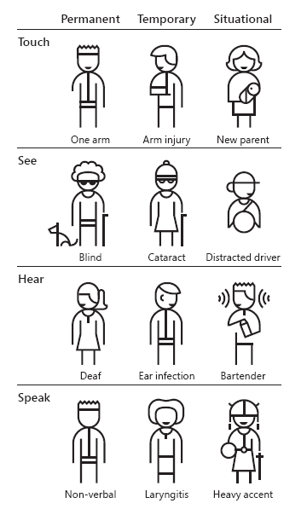
Inclusive Design
Solve for one, extend to many
By designing for a specific user or users, it can be useful for a greater whole
Microsoft CC BY-NC-ND

Slide 57
Design principles are great...

Slide 58
...but the best way to understand users is through usability testing.

Slide 59
Usability Testing Connects Users Directly with Designers and Developers

Slide 60
Types of Usability Testing
Card Sorting
Focus groups
Cognitive Walkthroughs

Slide 61
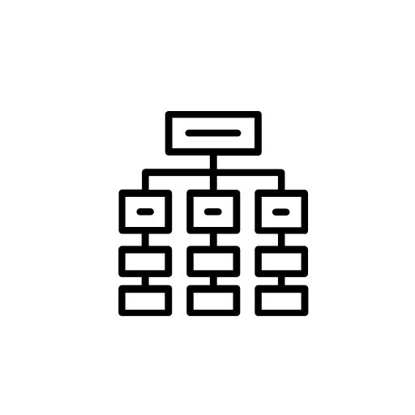
Types of Usability Testing
Card sorting
Card sorting is having a group of participants sort and categorize labels that makes sense to them.

Slide 62
Libraries and Usability
Card sorting
General patterns can be found and used to develop a navigation system.

Slide 63
Types of Usability Testing
Card sorting
Best used for the initial creation of a site or a navigation revamp.

Slide 64
Types of Usability Testing
Card sorting
Card sorting provides the opportunity to incorporate users’ language into the system.

Slide 65
Types of Usability Testing
Focus Groups
Can be informal or formal groups surveying users what they think of a website.

Slide 66
Types of Usability Testing
Focus Groups
Useful for general opinions.

Slide 67
Types of Usability Testing
Focus Groups
Has the potential to create a “mob mentality.”

Slide 68
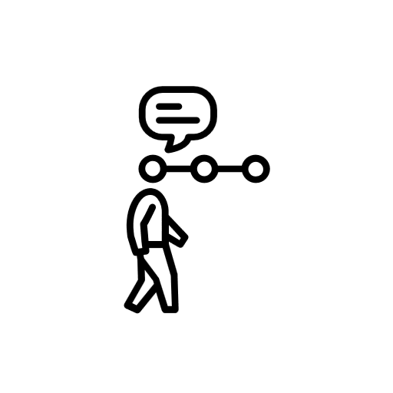
Types of Usability Testing
Cognitive Walkthroughs
Cognitive walkthroughs observe users how they navigate the site.

Slide 69
Types of Usability Testing
Cognitive Walkthroughs
Uses the “talk aloud protocol” TAP, where users verbally express what they are thinking as they are using the site.

Slide 70
Types of Usability Testing
Cognitive Walkthroughs
Used in conjunction with task scenario testing.

Slide 71
Types of Usability Testing
Cognitive Walkthroughs
Metrics to consider is if they succeed or fail a task, the time it takes to complete, and the web navigation that is traversed.

Slide 72
Why Should Libraries Care About Usability?

Slide 73
Libraries and Usability
Usability is important in libraries because of the many different systems we use.

Slide 74
Libraries and Usability
It can be jarring to be using the library website and then be sent to a database with a totally different interface.

Slide 75
Libraries and Usability
However, these jarring moments can be finessed with usability testing.

Slide 76
Libraries and Usability
This doesn’t just apply to digital spaces, but can be used to physical ones as well.

Slide 77
Libraries and Usability
Is the physical layout of the library conducive for finding materials?

Slide 78
Libraries and Usability
Challenges to usability testing in libraries
Time
Labor
Participants

Slide 79
Libraries and Usability
Time
Ideally usability testing should be done at least once a semester/twice a year.

Slide 80
Libraries and Usability
Labor
We all wear many hats!

Slide 81
Libraries and Usability
Participants
Finding participants can be challenging but alleviating with incentives.

Slide 82
Libraries and Usability
What are other challenges that you have encountered?

Slide 83
Wrapping Up
What is usability?
Why is usability testing important?
Usability and social justice
Types of usability testing
Libraries and usability

Slide 84
Questions?

Slide 85
Thanks!

