Slide 1


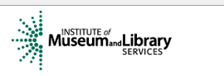
Implementing BIBFRAME: The UC Davis BIBFLOW Project
Xiaoli Li
Co-head of Content Support Services
University of California Davis Library
New York Technical Services Librarians
November 16, 2015

Slide 2
Outline
Introduction to BIBFRAME
  What is BIBFRAME?
  Goals for BIBFRAME
BIBFLOW Project
  What have been done?
  Where are we?
  Demo

Slide 3
PART I: What Is BIBFRAME?
BIBliographic FRAMEwork Initiative

Slide 4
What Is BIBFRAME?
Library Congress’ project started in 2011
It’s the replacement for MARC
  can and will serve as an encoding standard for RDA and other content standards
AND
It leverages the current web technology (sematic web/Linked Data) and uses Resource Description Framework (RDF) modeling practice.

Slide 5
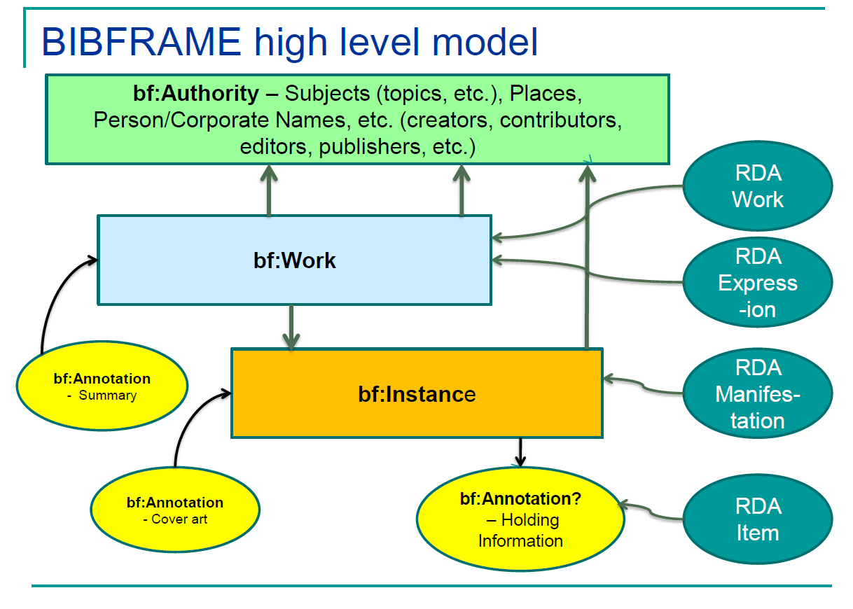
BIBFRAME 1.0
LC has proposed to change this to bf:Item.
Adapted from a presentation given by Sally McCallum, https://www.oclc.org/content/dam/oclc/events/2015/CI_SFPL_PPTS/BF-NCTPG-California.pdf

Slide 6
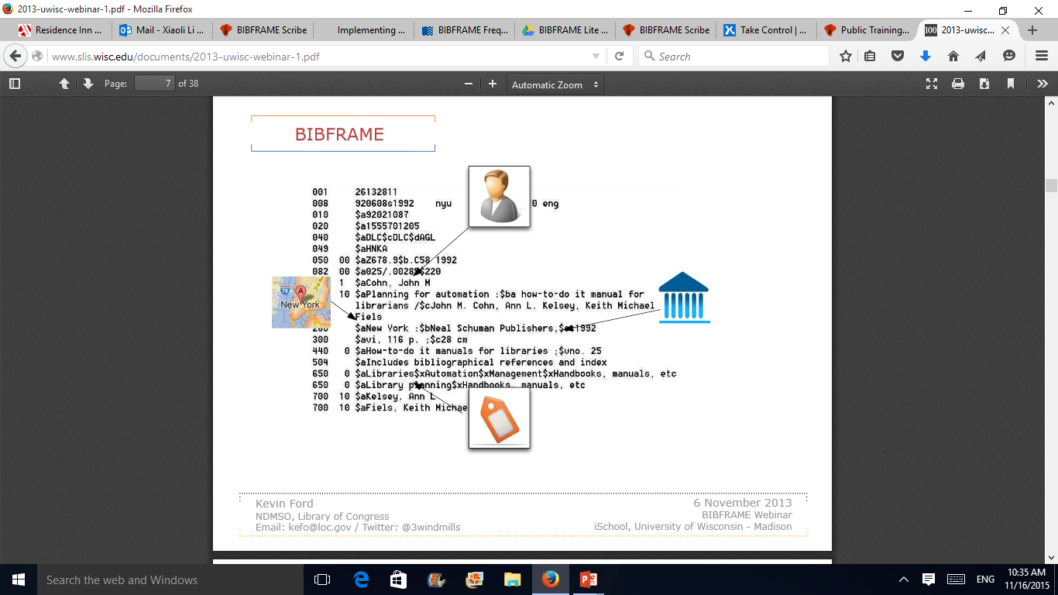
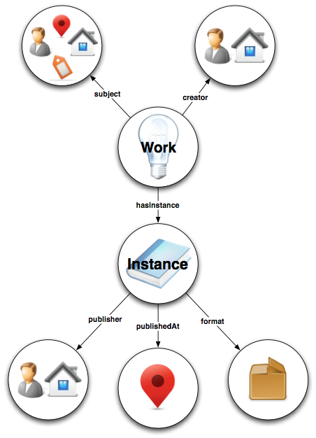
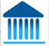

Slide 7
Goals for BIBFRAME
Supply search engines with description in a form they can exploit
Use/exploit linking
  traditional = textual, identifiers
  semantic technology = URIs URI – Uniform Resource Identifier
MARC transition
  enable reuse of data from MARC
  provision of transformations to new models
Extensibility to new and broader content
Accommodate needs for different types of libraries
New views of different types of metadata
  descriptive, authority, holdings
  coded data, classification data, subject data
  preservation, rights, technical, archival
Reconsideration of the data related activities
  exchange, internal storage, input interfaces and technique
Adapted from a presentation given by Sally McCallum, http://www.oclc.org/content/dam/oclc/events/2015/CI_SFPL_PPTS/BF-NCTPG-California.pdf

Slide 8
PART II: What Is BIBFLOW
  BIBframe + workFLOW

Slide 9
BIBFLOW Project
Is a 2-year project of the UC Davis University Library and Zepheira, funded by Institute of Museum and Library Sciences (May 2014 – April 2016)
Its official title is “Reinventing Cataloging: Models for the Future of Library Operations”
Is a research project that will address questions like “What impact will adoption of BIBFRAME on technical services workflows in an academic library”?
Its primary purpose is to understand ecosystem, test solutions, and provide a concrete map of how libraries can iteratively migrate to linked data without disrupting patron or business services.

Slide 10
How?

Slide 11
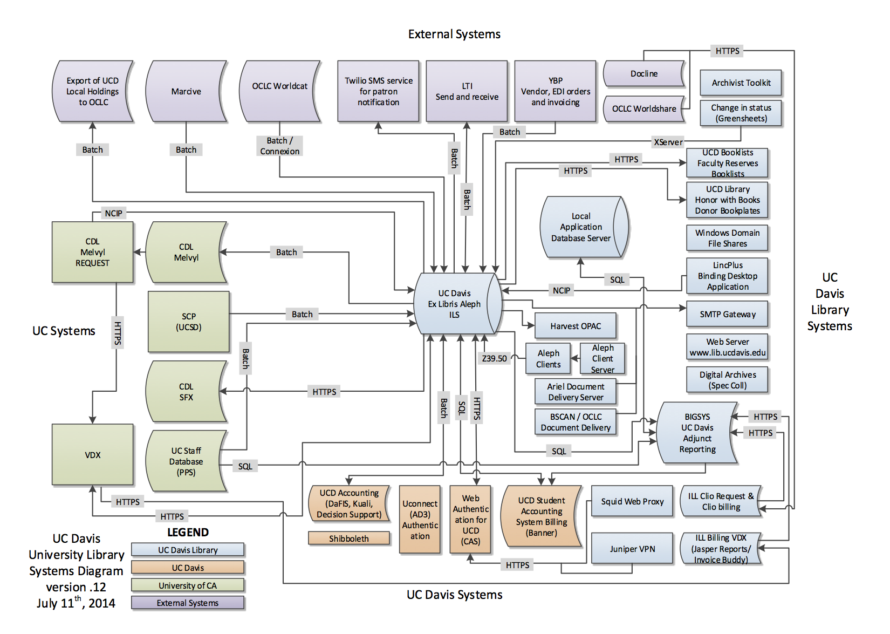

Slide 12
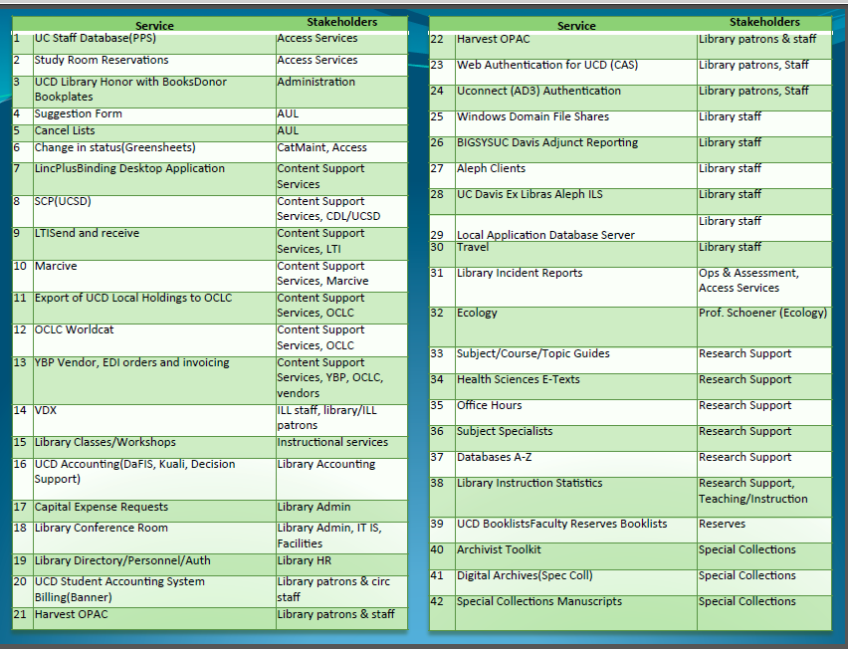

Slide 13
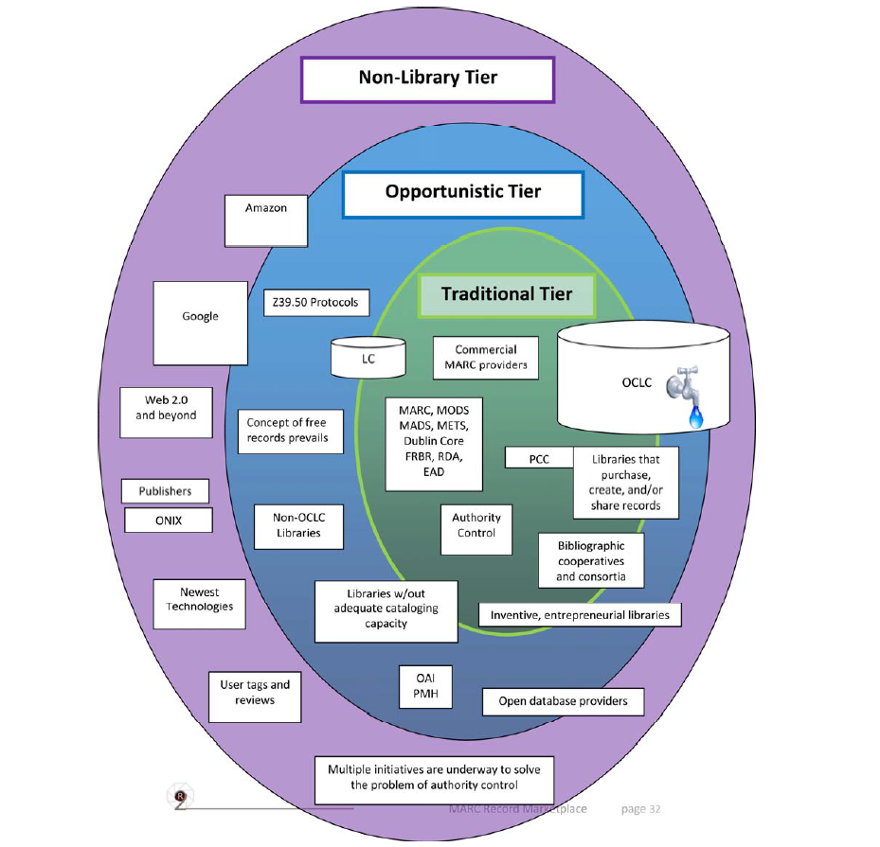
Ruth Fischer and Rick Lugg, http://www.loc.gov/bibliographic-future/news/MARC_Record_Marketplace_2009-10.pdf

Slide 14
This complexity leads to the inevitable conclusion that moving away from MARC into BIBFRAME represents an evolutionary leap for libraries and not a simple migration.

Slide 15
Workflows and Use Cases
BIBFLOW’s focus is on developing a roadmap for migrating essential library work efforts (workflows) to a BIBFRAME / LOD ecosystem. Library work involves daily engagement with a large collection of software systems, institutions, and vendors. As such, moving to a LOD ecosystem is not simply a matter of understanding its impact on library data but also on these complex workflows.

Slide 16


Melvyl (UC OPAC)
Harvest (UCD OPAC)
New Name Auth?
yes
OCLC WorldCat
Aleph
Vendor Service
Auth
Auth
Automated process (weekly done by Systems Dept)
yes
Auth Control
New Sub Heading?
Propose to LC
Bib
Bib
Create holdings record
Add/complete item record
Physical Processing Unit
Original Cataloging Workflow for Print Monographs

Slide 17
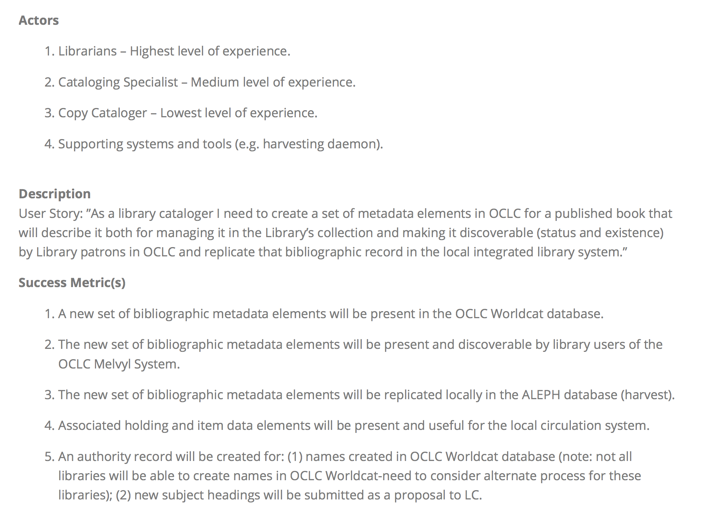
Use Case: Original Non-Rare Print Book Cataloging Using OCLC Connexion Client

Slide 18
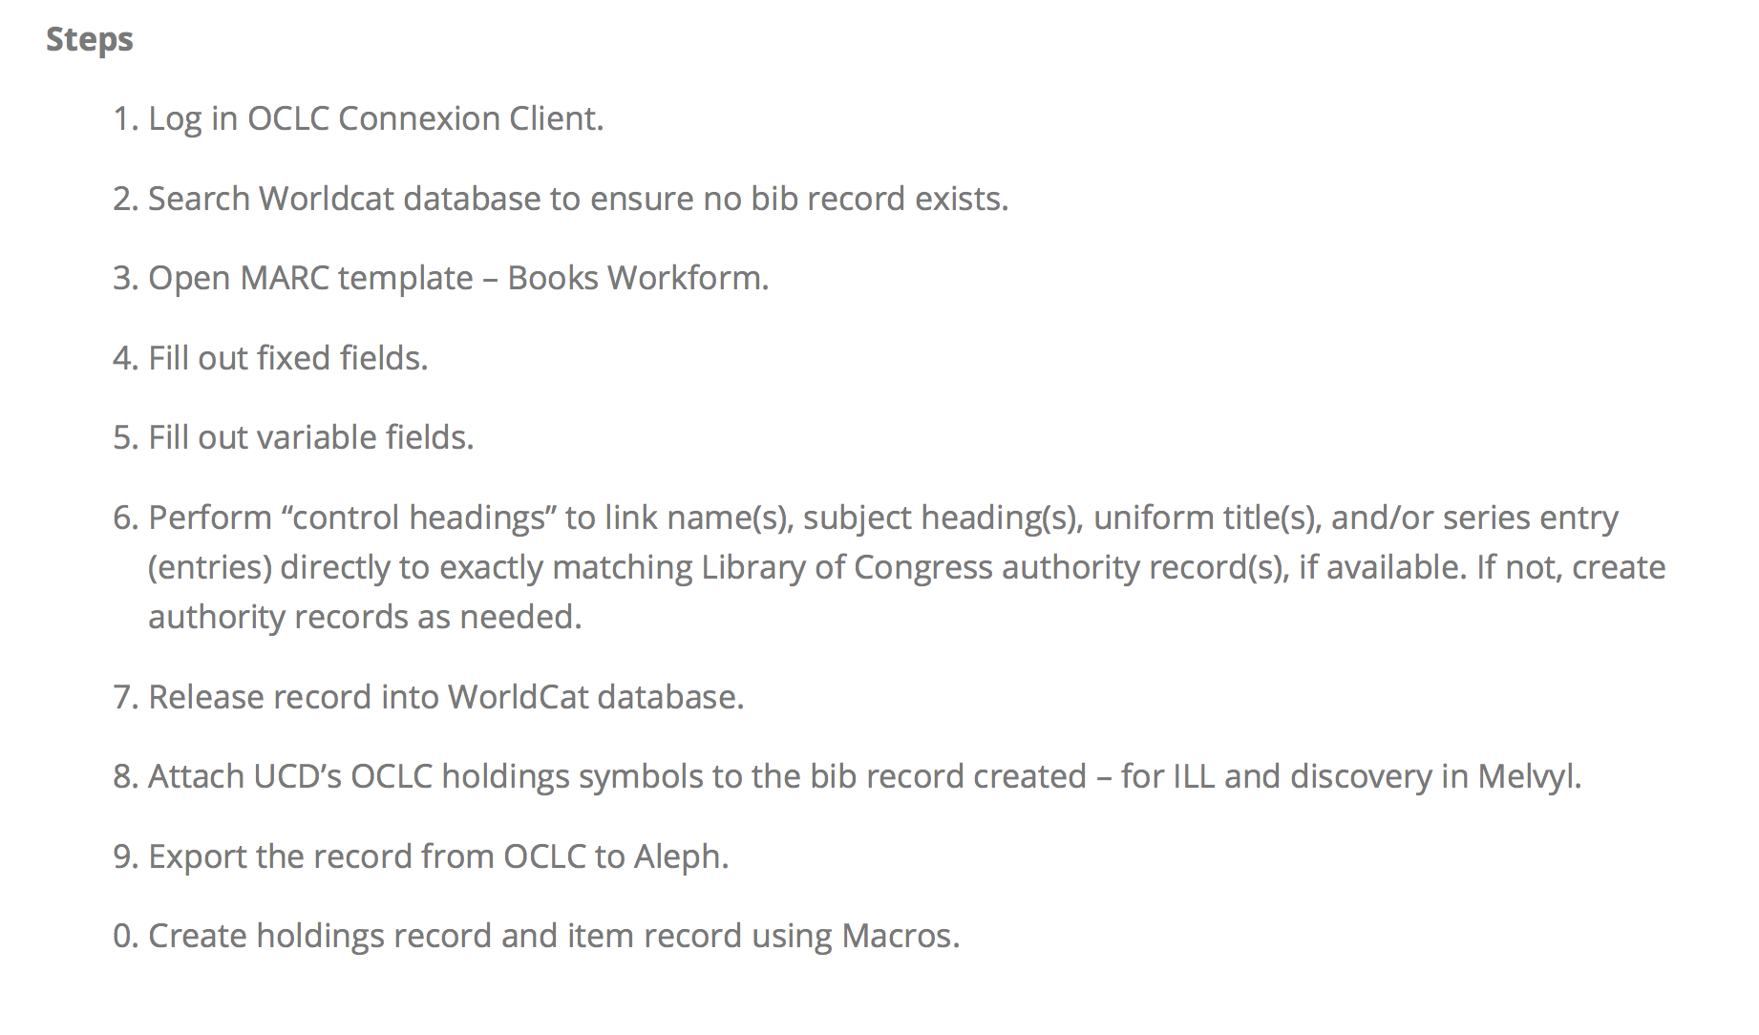

Slide 19
Assessment of Library Management System
To make the transition into BIBFRAME possible, library community needs a linked data oriented system.

Slide 20
Key Findings about Kuali-OLE
OLE 1.0 (latest release at the time when we reviewed the product in 2014) is not cable of supporting LOD/BIBFRAME operations.
However,
OLE’s bibliographic database (DocumentStore) is robust, extensible, and capable in its current form of dealing with linked data. This is advantageous from a development perspective.
For more information, visit our project blog: http://www.lib.ucdavis.edu/bibflow/initial-kuali-ole-assessment/

Slide 21
Based on identified workflows and the Kauli-OLE assessment, we developed a preliminary LOD/BIBFRAME implementation model. This model allows for the gradual, phased shifting of library work efforts from a MARC to LOD/BIBFRAME ecosystem such that all workflows will function and communicate with each other synchronously regardless if they are LOD/BIBFRAME or MARC native.

Slide 22
Where Are We?

Slide 23
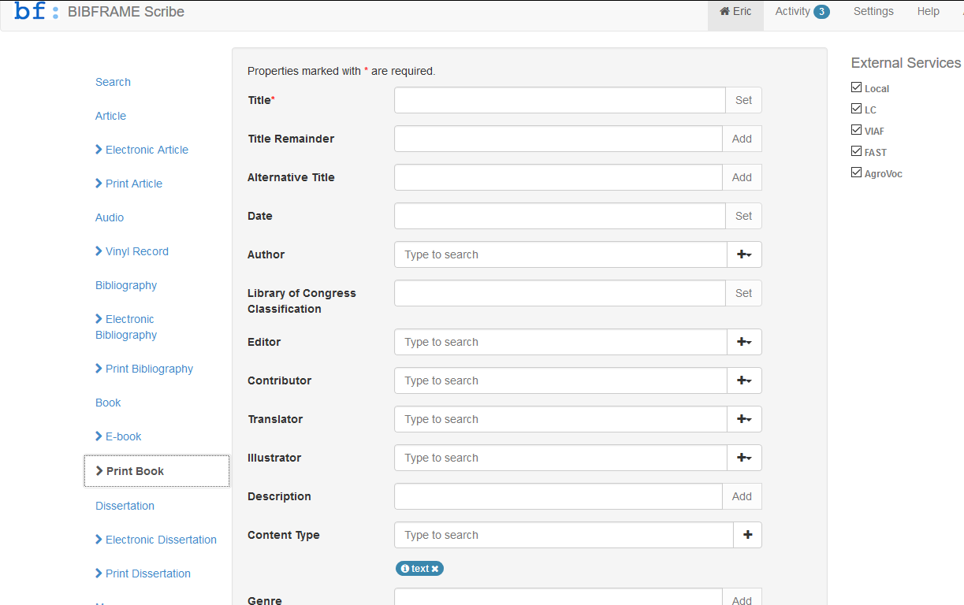

Slide 24
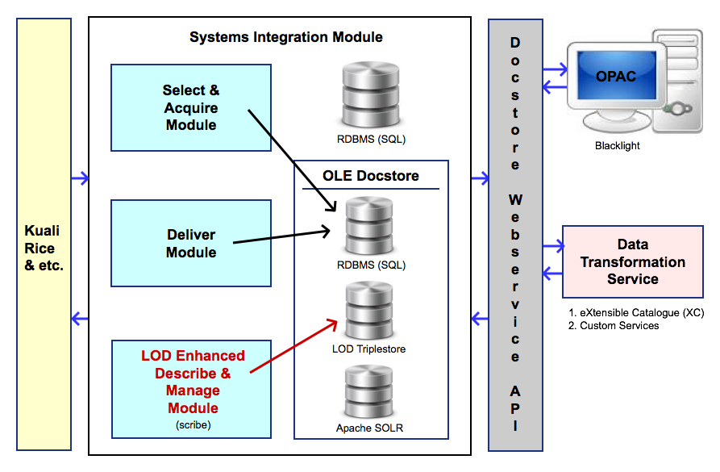
Kauli-OLE for BIBFRAME

Slide 25
Testing Workflows
Original cataloging of non-rare print books
Copy cataloging of non-rare print books
Original cataloging of electronic books
Original cataloging of electronic dissertations
Original cataloging of print maps
Original cataloging of print serials
Personal and corporate name authority record creation
Original cataloging of rare non-book items

Slide 26
Preparing for MARC2BIBFRAME Conversion
Evaluating conversion tools:
  Library of Congress’s MARC to BIBFRAME transformation Service
    http://bibframe.org/tools/transform/start
  Zepheira’s transformation tool
    https://linksmith.zepheira.com/training/ (password required)
Evaluating data ingesting tools:
  Karma: http://usc-isi-i2.github.io/karma/
  eXtensible Catalog: http://www.extensiblecatalog.org/

Slide 27
Demo

Slide 28
DEMO #1
Input Subject Terms
Using Scribe (Zepheira’s BIBFRAME Editor)

Slide 29

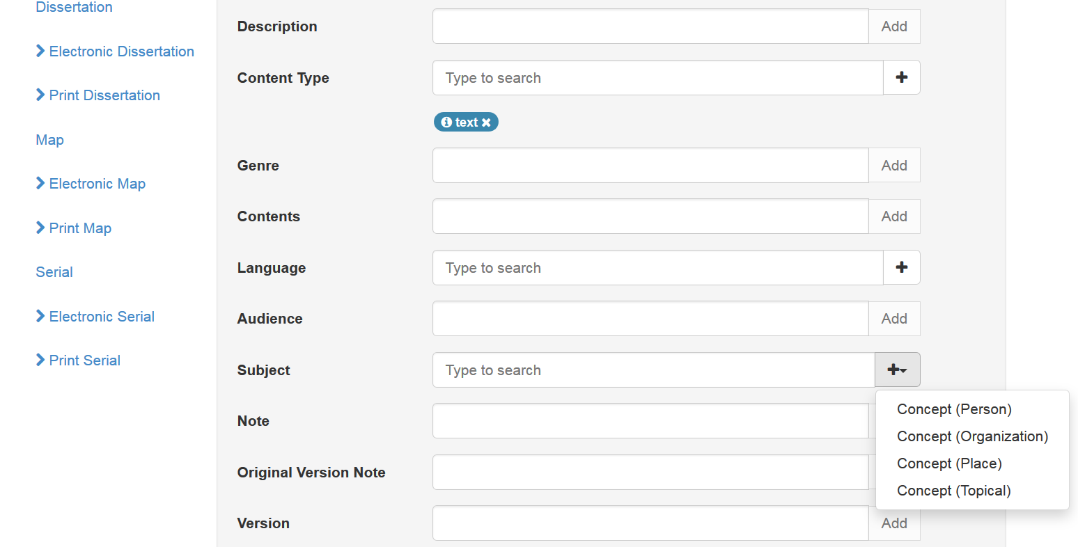

Slide 30
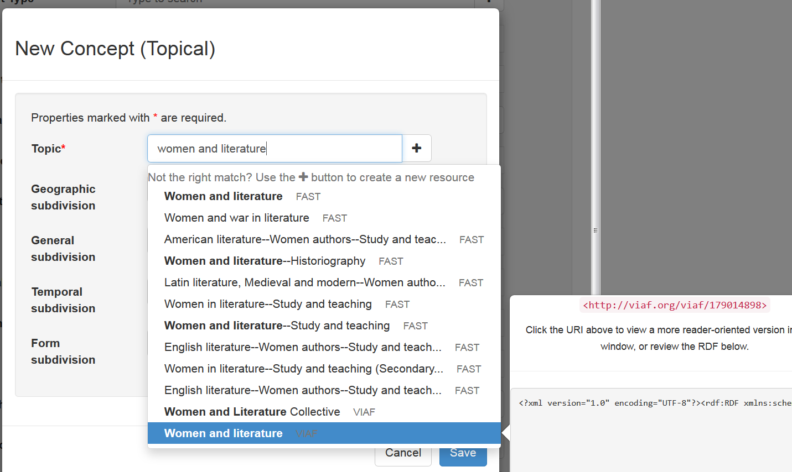

Slide 31
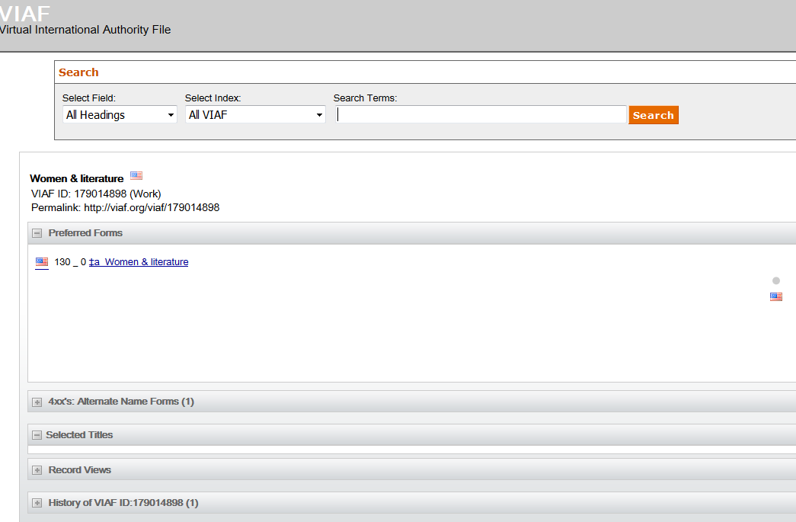
Link out to VIAF from Scribe

Slide 32
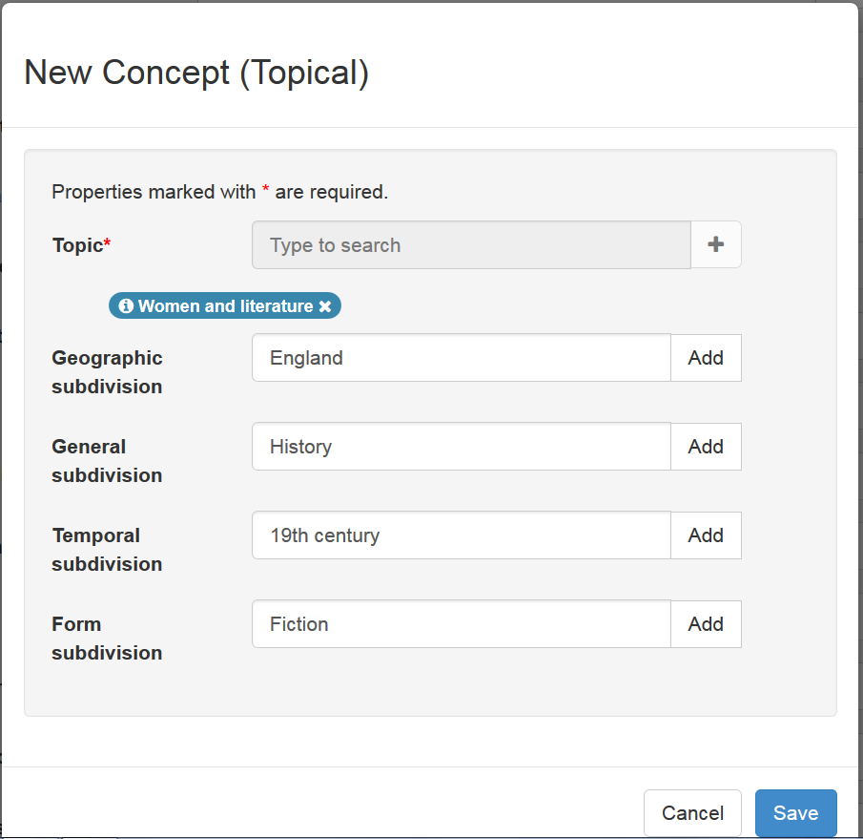

Slide 33
Demo #2:
Workflow - Auto Fill Data Elements Retrieved from OCLC

Slide 34

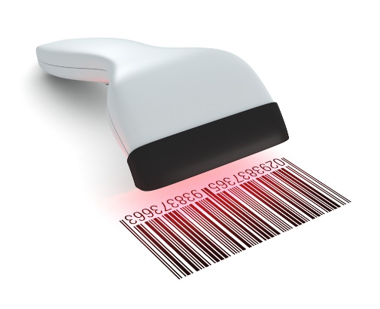
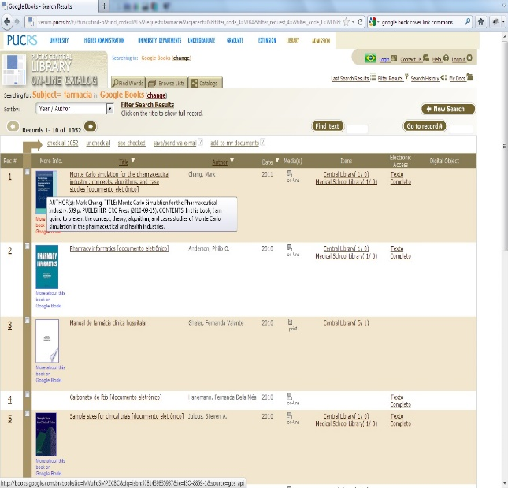
Idea Workflow: Scan Barcode
Automated Copy Cataloguing
Linked Data Facilitated

Slide 35
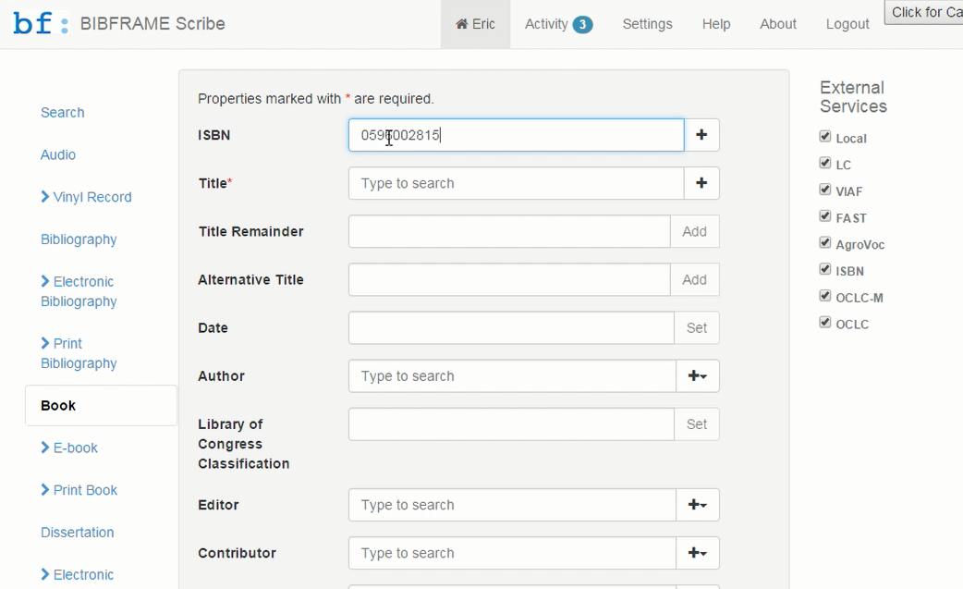

Slide 36
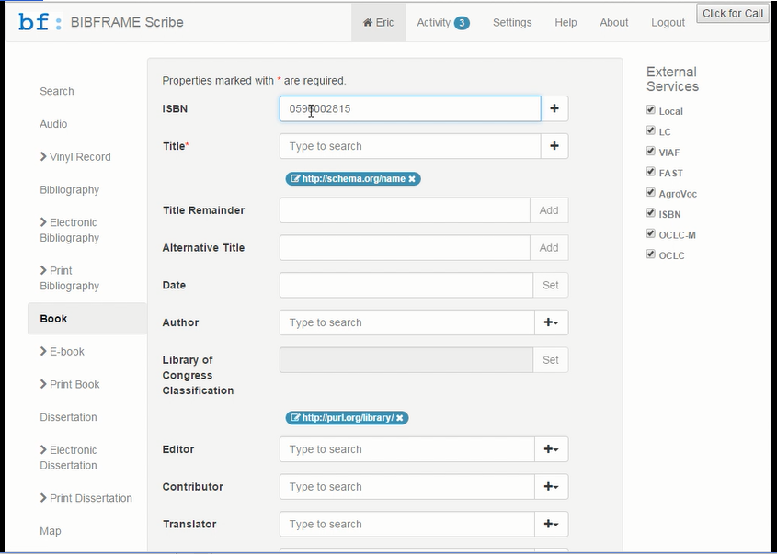
Work in Progress

Slide 37
Demo #3:
MARC BIBFRMAE

Slide 38
Issues
Subject headings
  can not locate trusted URI for every pre-coordinated string (e.g., ID.LOC.GOV)
Name headings
  can not locate URI for every one from ID.LOC.GOV
Multiple work identifiers for the same work
  how to de-dup?
Records created following different cataloging rules or practices:
  latest entry record (serials) will become multiple works and instances
  composite record (p+e) will become one work and multiple instances
  Record for reproduction (description was based on original) – data which is for the original needs to be ignored
….

Slide 39
Issue – Subject Headings

Slide 40
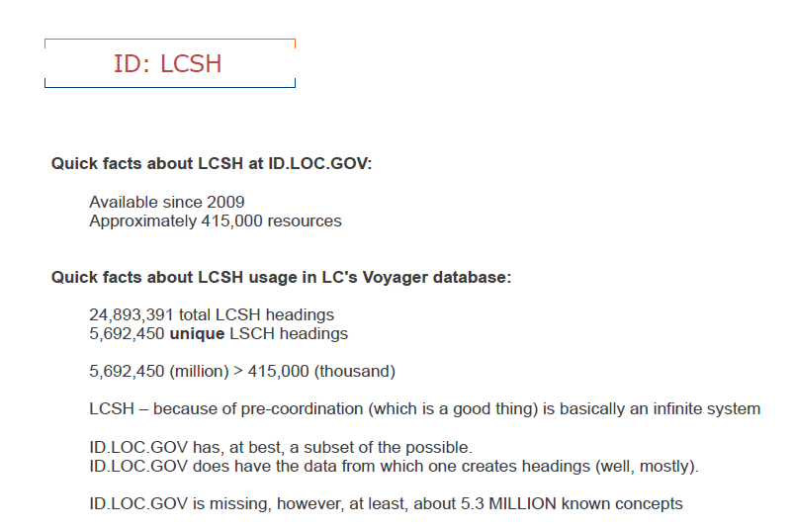
Kevin Ford, http://www.loc.gov/bibframe/pdf/ALAmw2013-sac_Ford.pdf

Slide 41
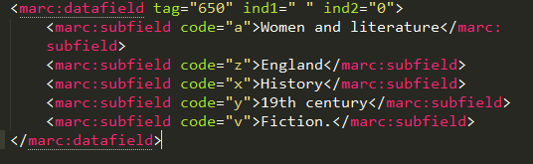
Subject Heading with Form Subdivision
Women and literature--England--History--19th century--Fiction

Slide 42
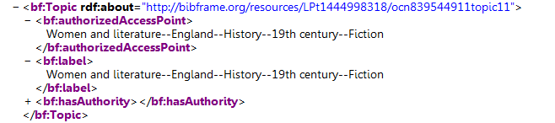
LC BIBFRAME Transformation
http://bibframe.org/resources/LPt1444998318/

Slide 43
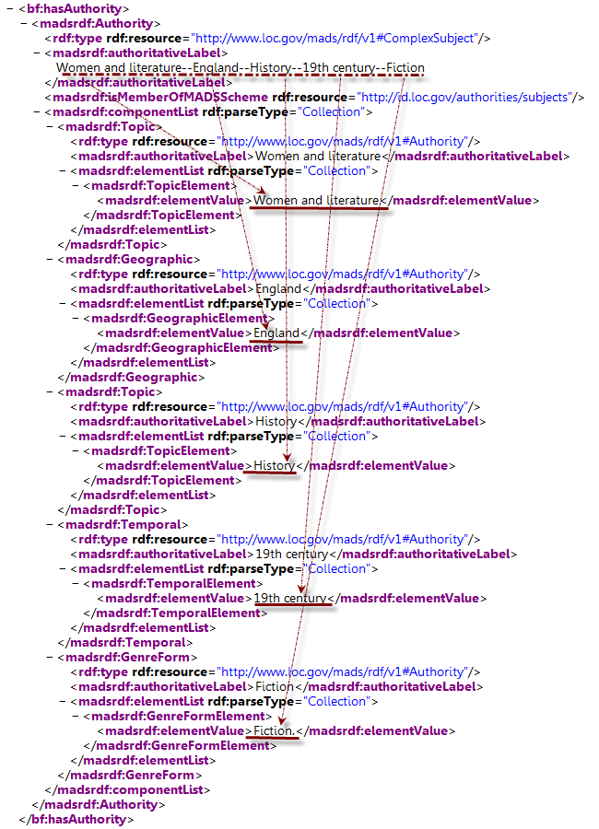
LC BIBFRAME Transformation

Slide 44
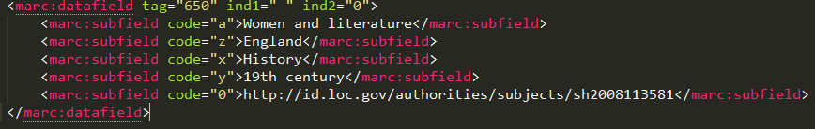
Subject Heading without Form Subdivision
Women and literature--England--History-- 19th century--Fiction
http://id.loc.gov/authorities/subjects/sh2008113581

Slide 45
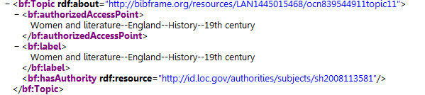
LC BIBFRAME Transformation
Without form subdivision
URI
http://bibframe.org/resources/LAN1445015468/
With form subdivision
Not a URI

Slide 46
Questions?
“What are the benefits (or not) of removing form subdivisions from subject headings in favor of faceted identification of genre/form in the bibliographic record/resource?” – Kevin Ford
The question I am interested is:
What are the benefits (or not) of removing ALL subdivisions from subject headings in favor of faceted navigation offered by next-gen discovery platform?

Slide 47
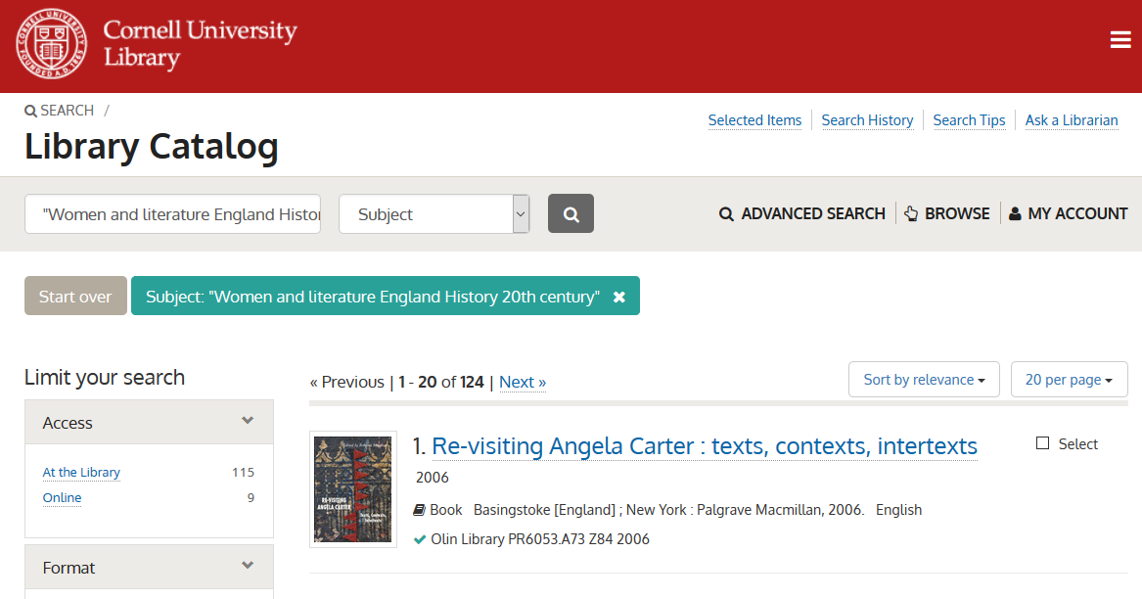
Subject string search

Slide 48
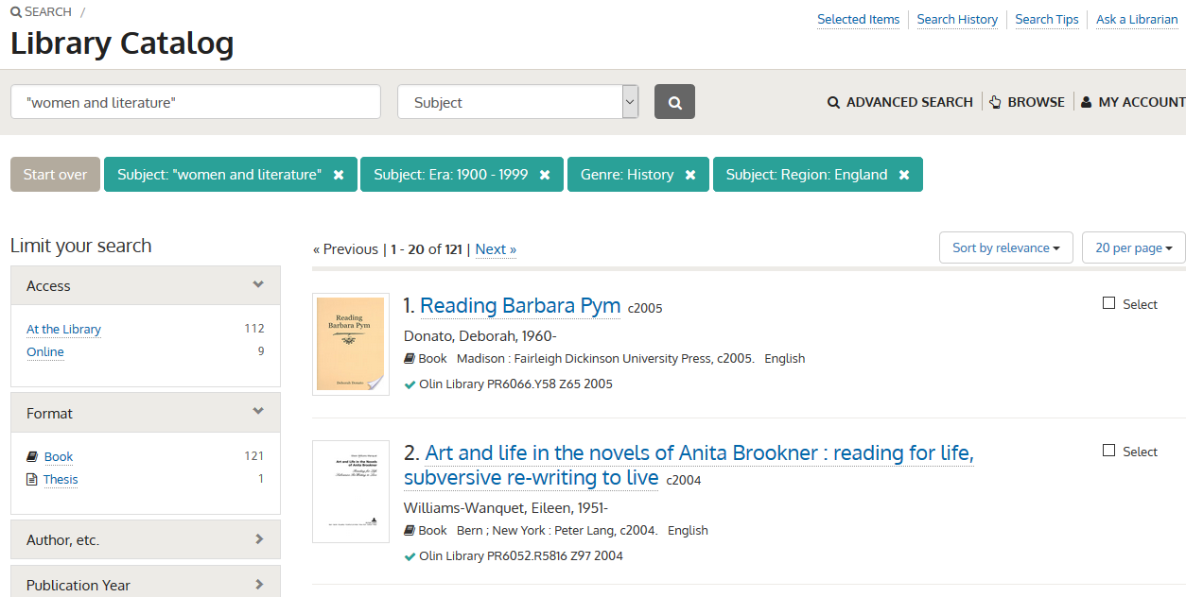
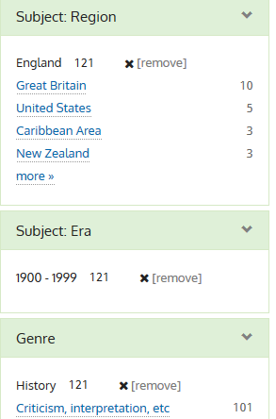
Using limits to refine the search

Slide 49
Issue – Name Headings

Slide 50
Melvyl (UC OPAC)
Harvest (UCD OPAC)
New Name
Auth?
yes
New Name Auth?
Currently catalogers needs to create name authority record in OCLC first
OCLC WorldCat
Aleph
Vendor Service
Auth
Auth
Automated process (weekly done by Systems Dept)
yes
Auth Control
New Sub Heading?
Propose to LC
Bib
Bib
Create holdings record
Add/complete item record
Physical Processing Unit
Original Cataloging Workflow for Print Monographs

Slide 51

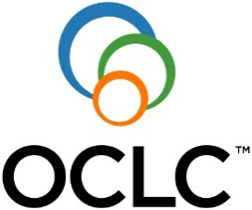
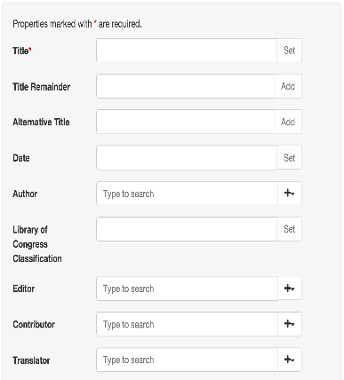
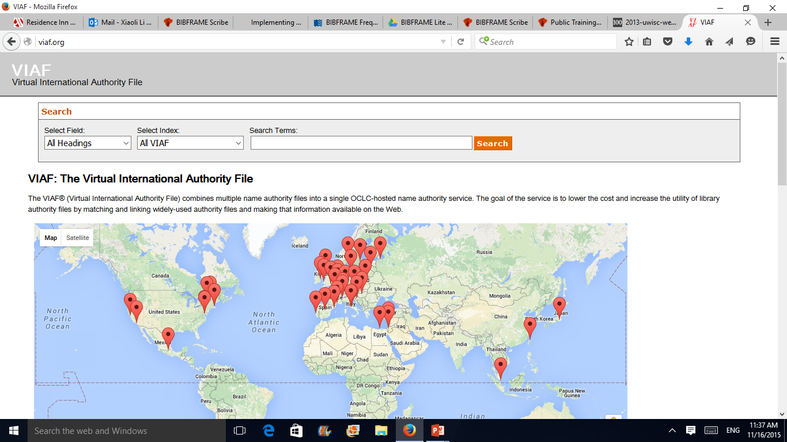
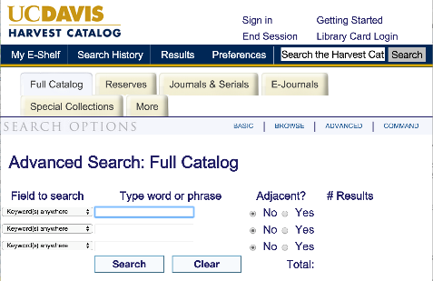
Possible Future Workflow for Creation of Name Identifier
Other Data Sources
owl:sameAs
Mint
Local URI

Slide 52
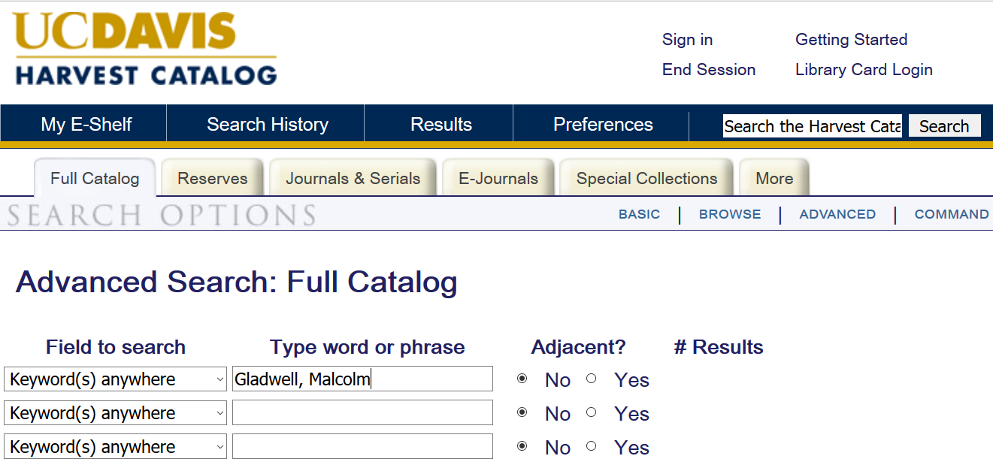
Current Discovery System Using MARC Data

Slide 53

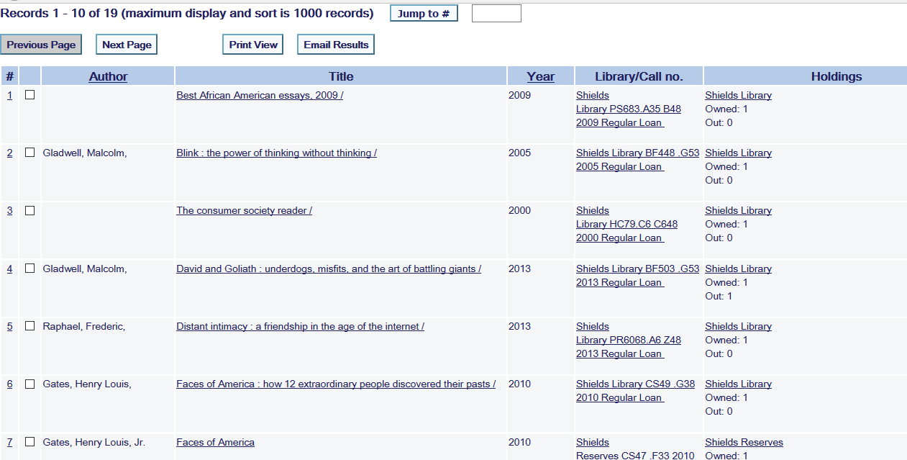
Display of the Search Results

Slide 54
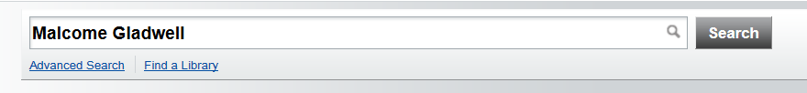
Possible Future Discovery System Using Linked Data

Slide 55
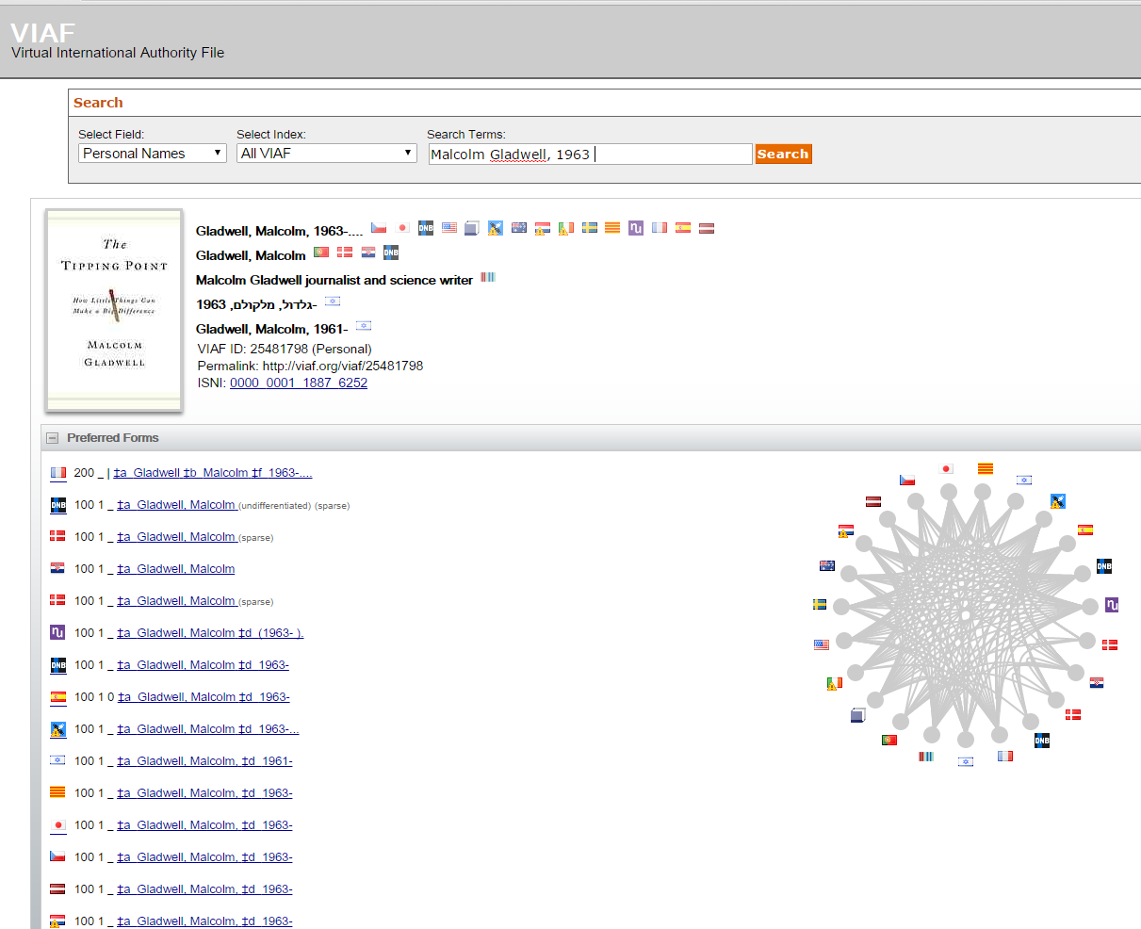
Pulling Data from VIAF

Slide 56
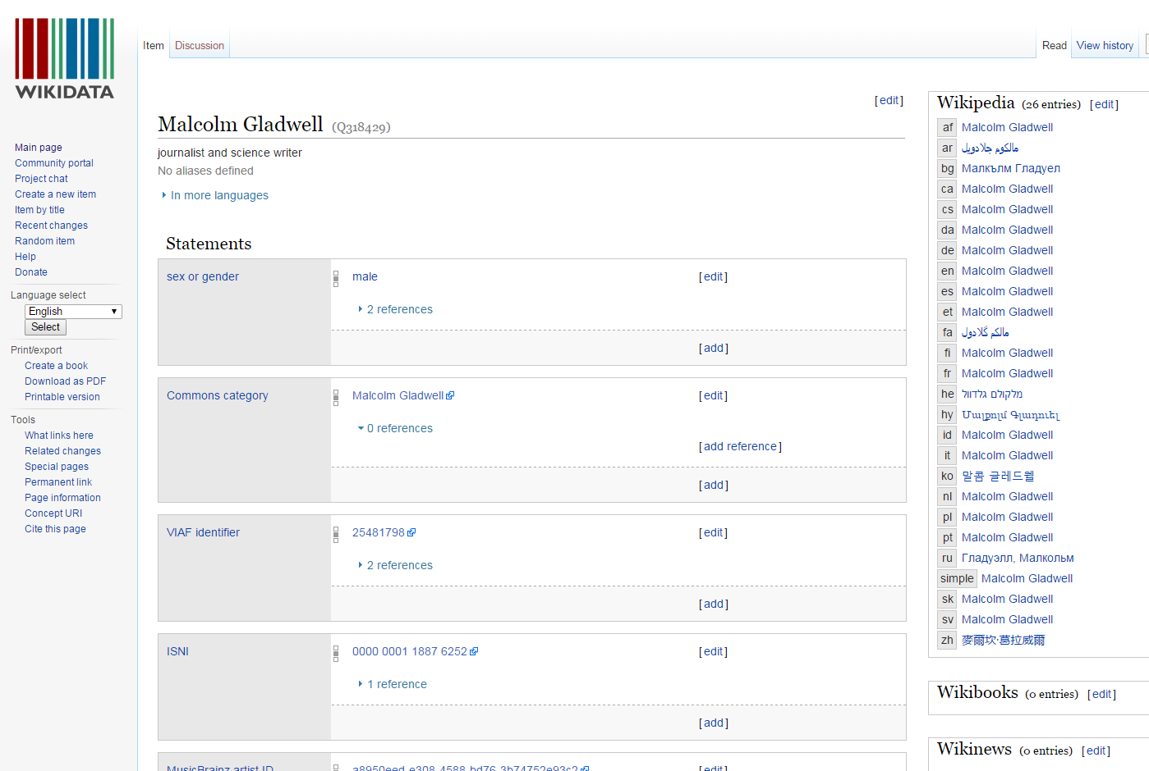
Pulling Data from WikiData

Slide 57
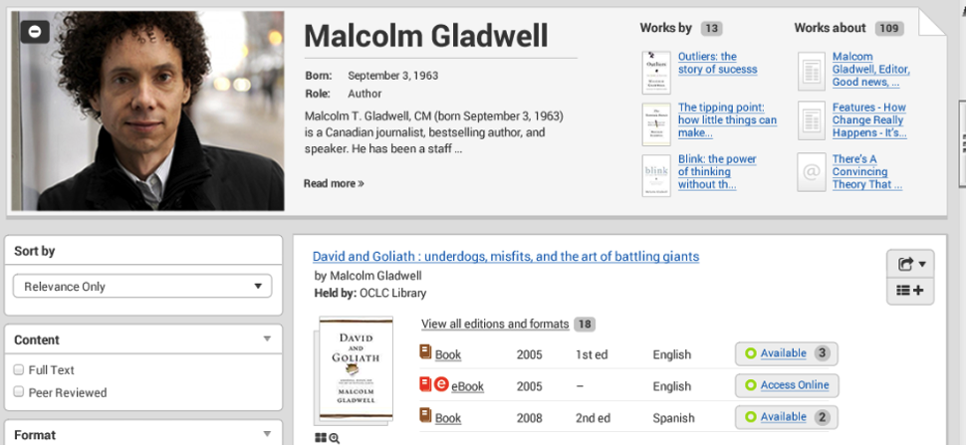
Display of the Search Results
Mockup
This work uses content that is from How You Can Make the Transition from MARC to Linked Data Easier © OCLC, used under a Creative Commons Attribution 4.0 International License: http://creativecommons.org/licenses/by/4.0/.

Slide 58
References
McCallum, S. (2015). BIBFRAME Update – Why, What, When [PDF document]. Retrieve from https://www.oclc.org/content/dam/oclc/events/2015/CI_SFPL_PPTS/BF-NCTPG-California.pdf
Ford, K. (2013). When URIs become authority: Benefits and challenges of library Linked Data [PDF document ]. Retrieved from
http://www.loc.gov/bibframe/pdf/ALAmw2013-sac_Ford.pdf
Fischer, R. and Lugg R. (2009). Study of the North American MARC Records Marketplace. Retrieved from
http://www.loc.gov/bibliographic-future/news/MARC_Record_Marketplace_2009-10.pdf
Godby, J. and Smith-Yoshimura, K. (2015). How You Can Make the Transition from MARC to Linked Data Easier. Retrieved from
http://www.oclc.org/content/dam/research/events/2015/marc-to-linked-data-webinar.pptx

Slide 59

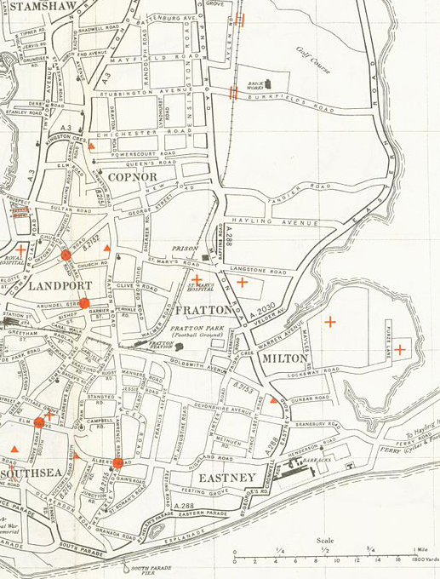



BIBFLOW: A Roadmap for Success
Thank you!

